Slide 1
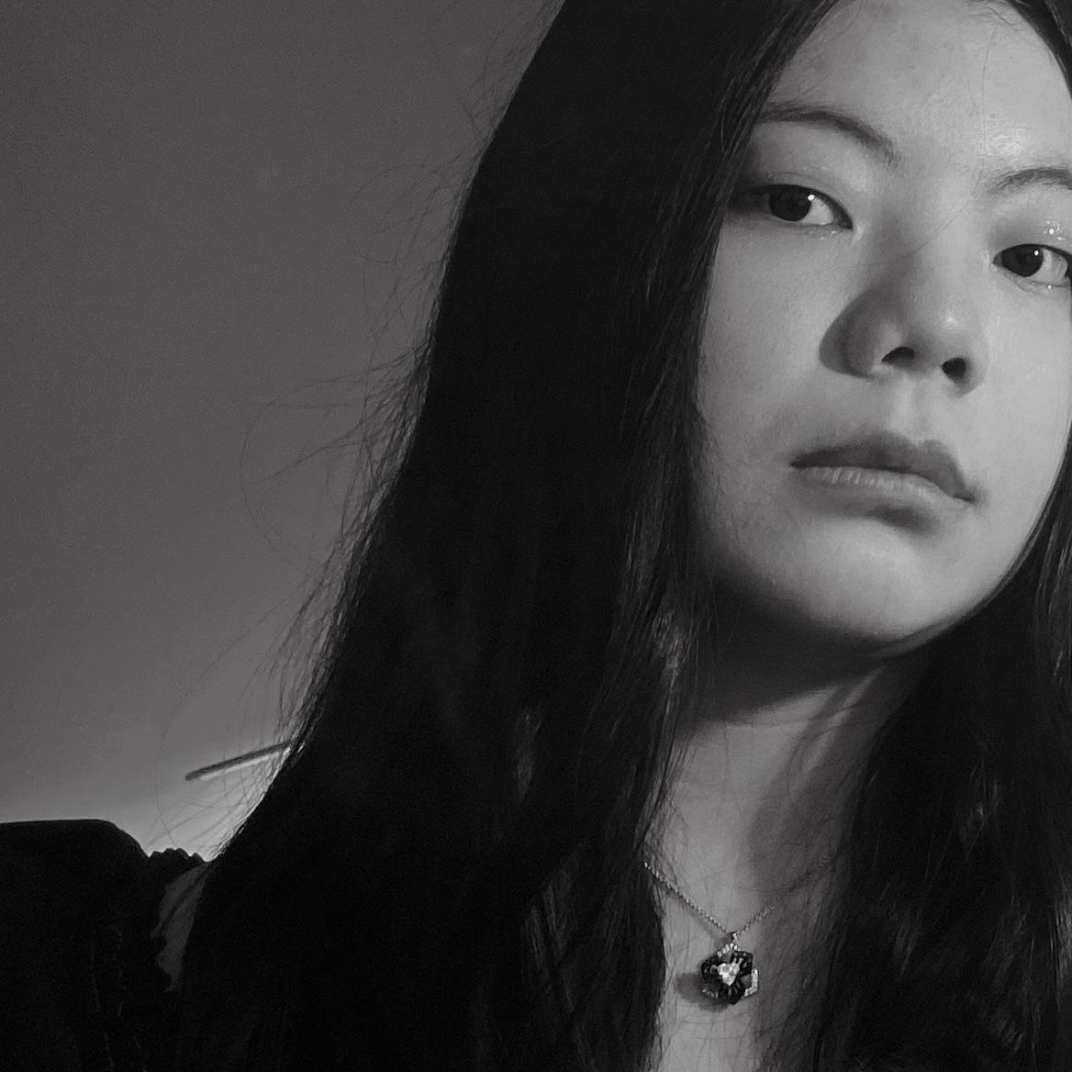
Yixuan Wu
Yixuan Wu is a Chinese-born illustrator and artist based in New York City. Growing up in a place with thousands of years of history, she gravitates to historical visual traditions. These encompass both Asia and Western world, as well as vintage film and theatrical works. She adapts these traditions for contemporary subject matter, using her modern and female perspective.
Yixuan crafts dusky, romantic, antique worlds, where pure fantasy mixes with her own lived experience. Within these worlds, Yixuan tells contemporary stories based on mythologies and folklore.
Website: https://artbyyixuan.myportfolio.com/
Instagram: _yixuan.wu_
Photo/Headshot

Slide 2
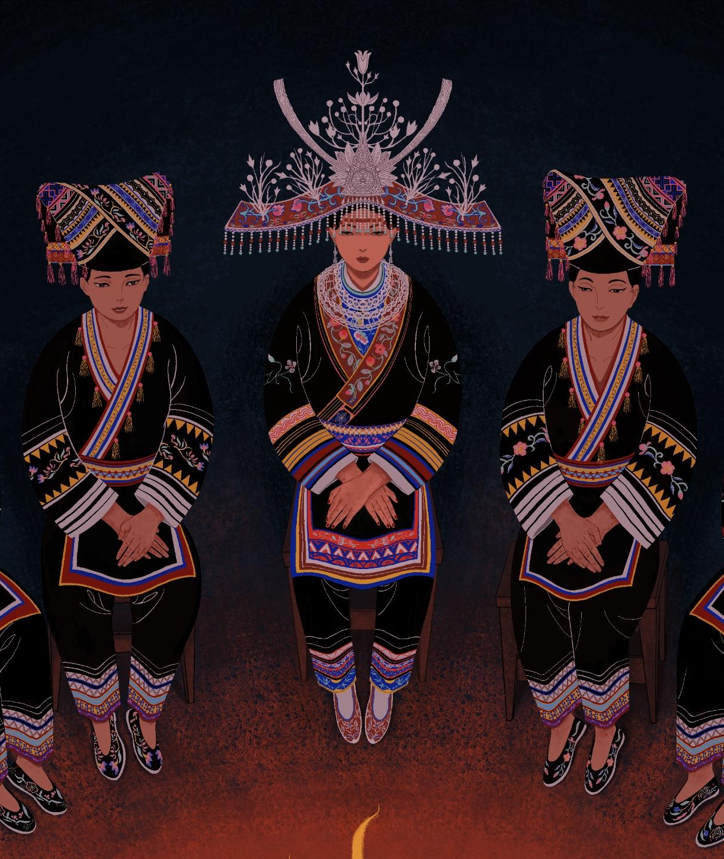
Women’s Script: Teardrops Of The Stars
The title of my Visual Thesis is Women’s Script: Teardrops Of The Stars.
Women's Script(女书/Nüshu) is a Chinese syllabic script that was used exclusively among women. During the time period when women lacked the right to receive a standard education, women in Jiangyong County, southern China created a unique script and used it to express their emotions and record their lives. They wrote down stories about the sadness and loneliness of the bitter side of their life, as well as the great power of friendship and sisterhood; since the shapes of the letters are slender and exquisite, they can also be embroidered on clothes or accessories as patterns.
To celebrate the life of these women and the legacy of this female-only language, I have developed my thesis based on those who created and used the secret language and the local Yao culture. The subtitle, Teardrops Of The Stars, comes from an interview with Ms.Yanxin Ho, an old Jiangyong lady who grew up with the culture. To her, the letters ‘were born from the sky, no need to be afraid.’
For me, the story of Women’s Script is a story about women's bravery, creativity and rebellion against patriarchal society. And my goal is to bring awareness of their voice to more people, especially women from all backgrounds.
Detail of one of your images

Slide 3
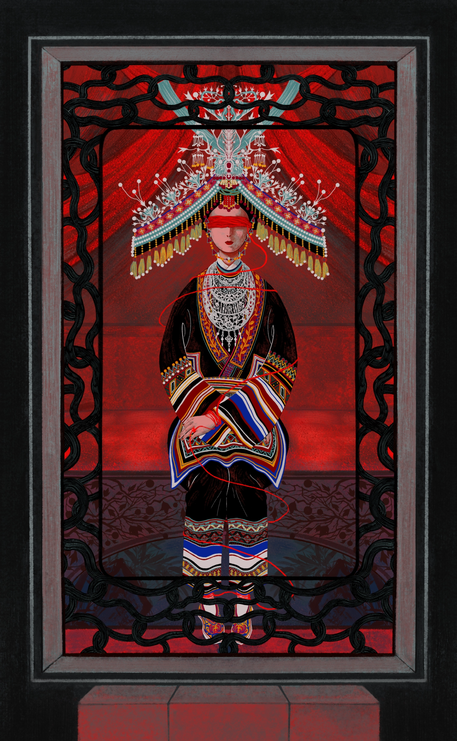
Red Line of Marriage
Digital
13x21

Slide 4
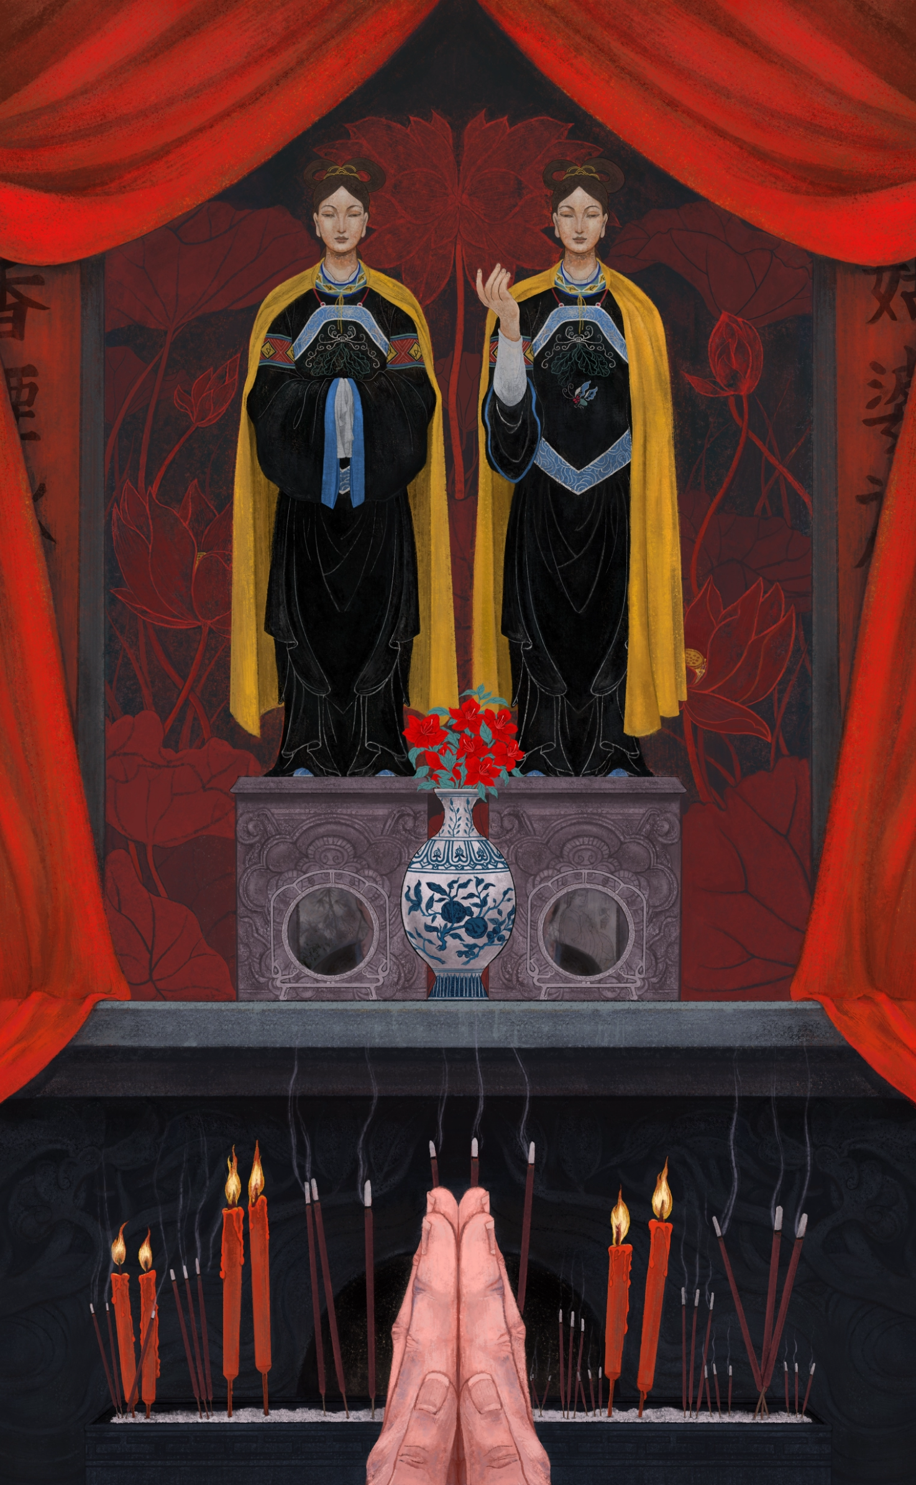
The Temple
Digital
13x21

Slide 5
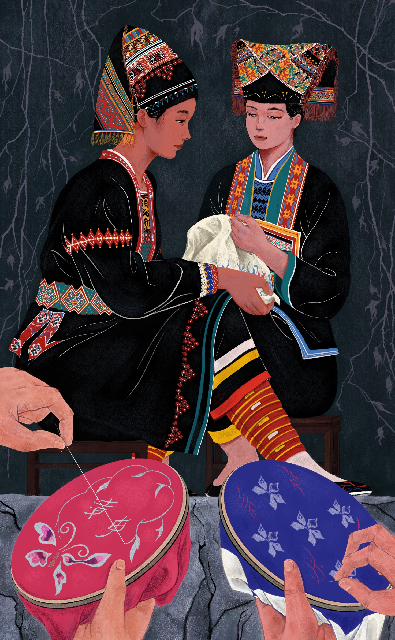
Sisterhood
Digital
13x21

