Slide 1
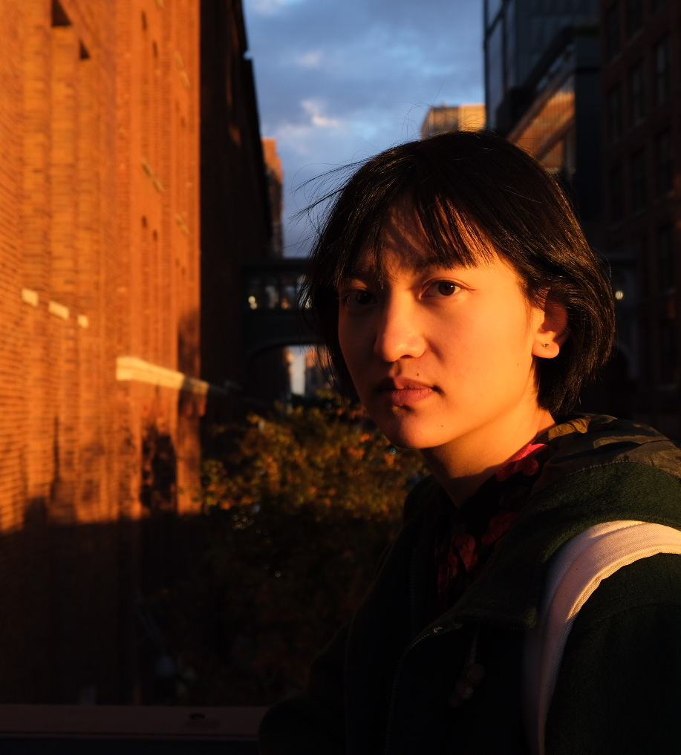
Ti Xu
I am an illustrator and comic artist from China, currently based in New York.
With a BFA degree of product design in undergrad, I received training in imagining things in three dimensions. This shapes my way of understanding and approaching illustrations: I create imaginary worlds full of depth and numerous facets.
My art practice is uncurbed and messy, as is my enthusiasm in exploring a diversity of mediums and genres, including comics, posters and animations.
https://tixuvisualgrocery.com/

Slide 2
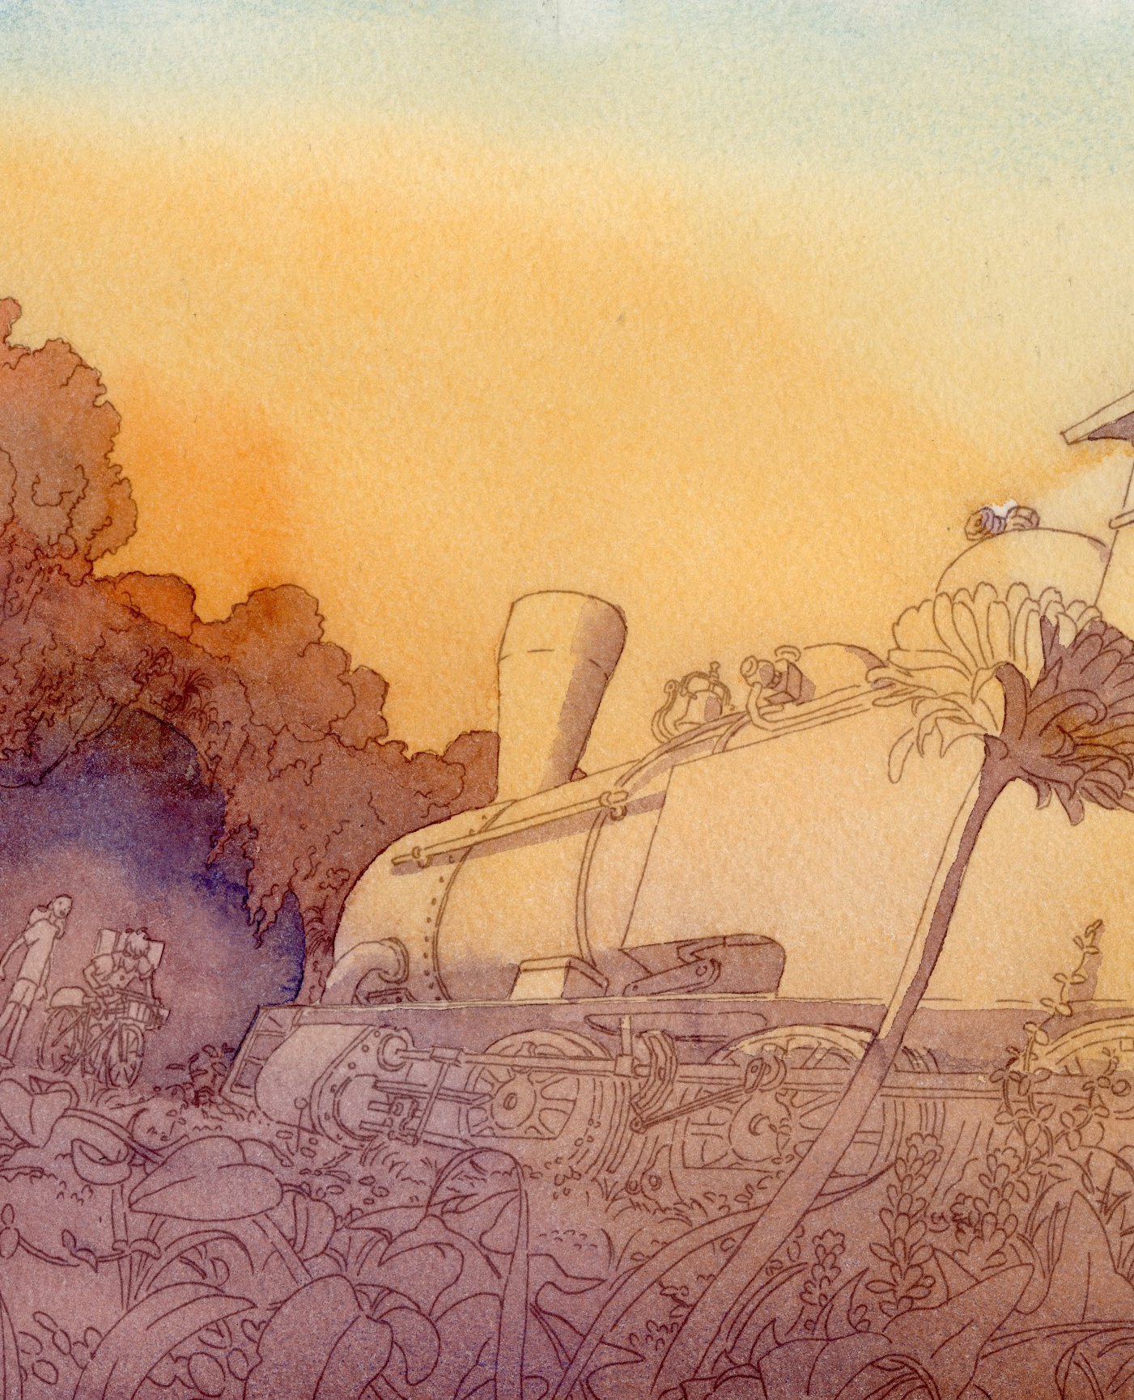
The Station
This project is a graphic novel named The Station. The story is divided into two parts, with the project covering the first part of 38 pages.
The story is about a young explore enthusiast, Somebody, who has a great prospect for his trip, and is convinced that renovating a long deserted locomotive is the best and only way for him to start his journey. As he takes pride in his competence of fixing the steam locomotive, he becomes unaware of the deeprooted fear he has for actually starting the trip. Thus he never left the station where the locomotive went into desertion with the train route, until a young biker, Raven, entered the near-abandoned place by accident. As a totally different character from his own, she challenged his way of being and eventually encouraged him to leave behind his fears and face his real yearning: to explore the unknown, outer world.

Slide 3
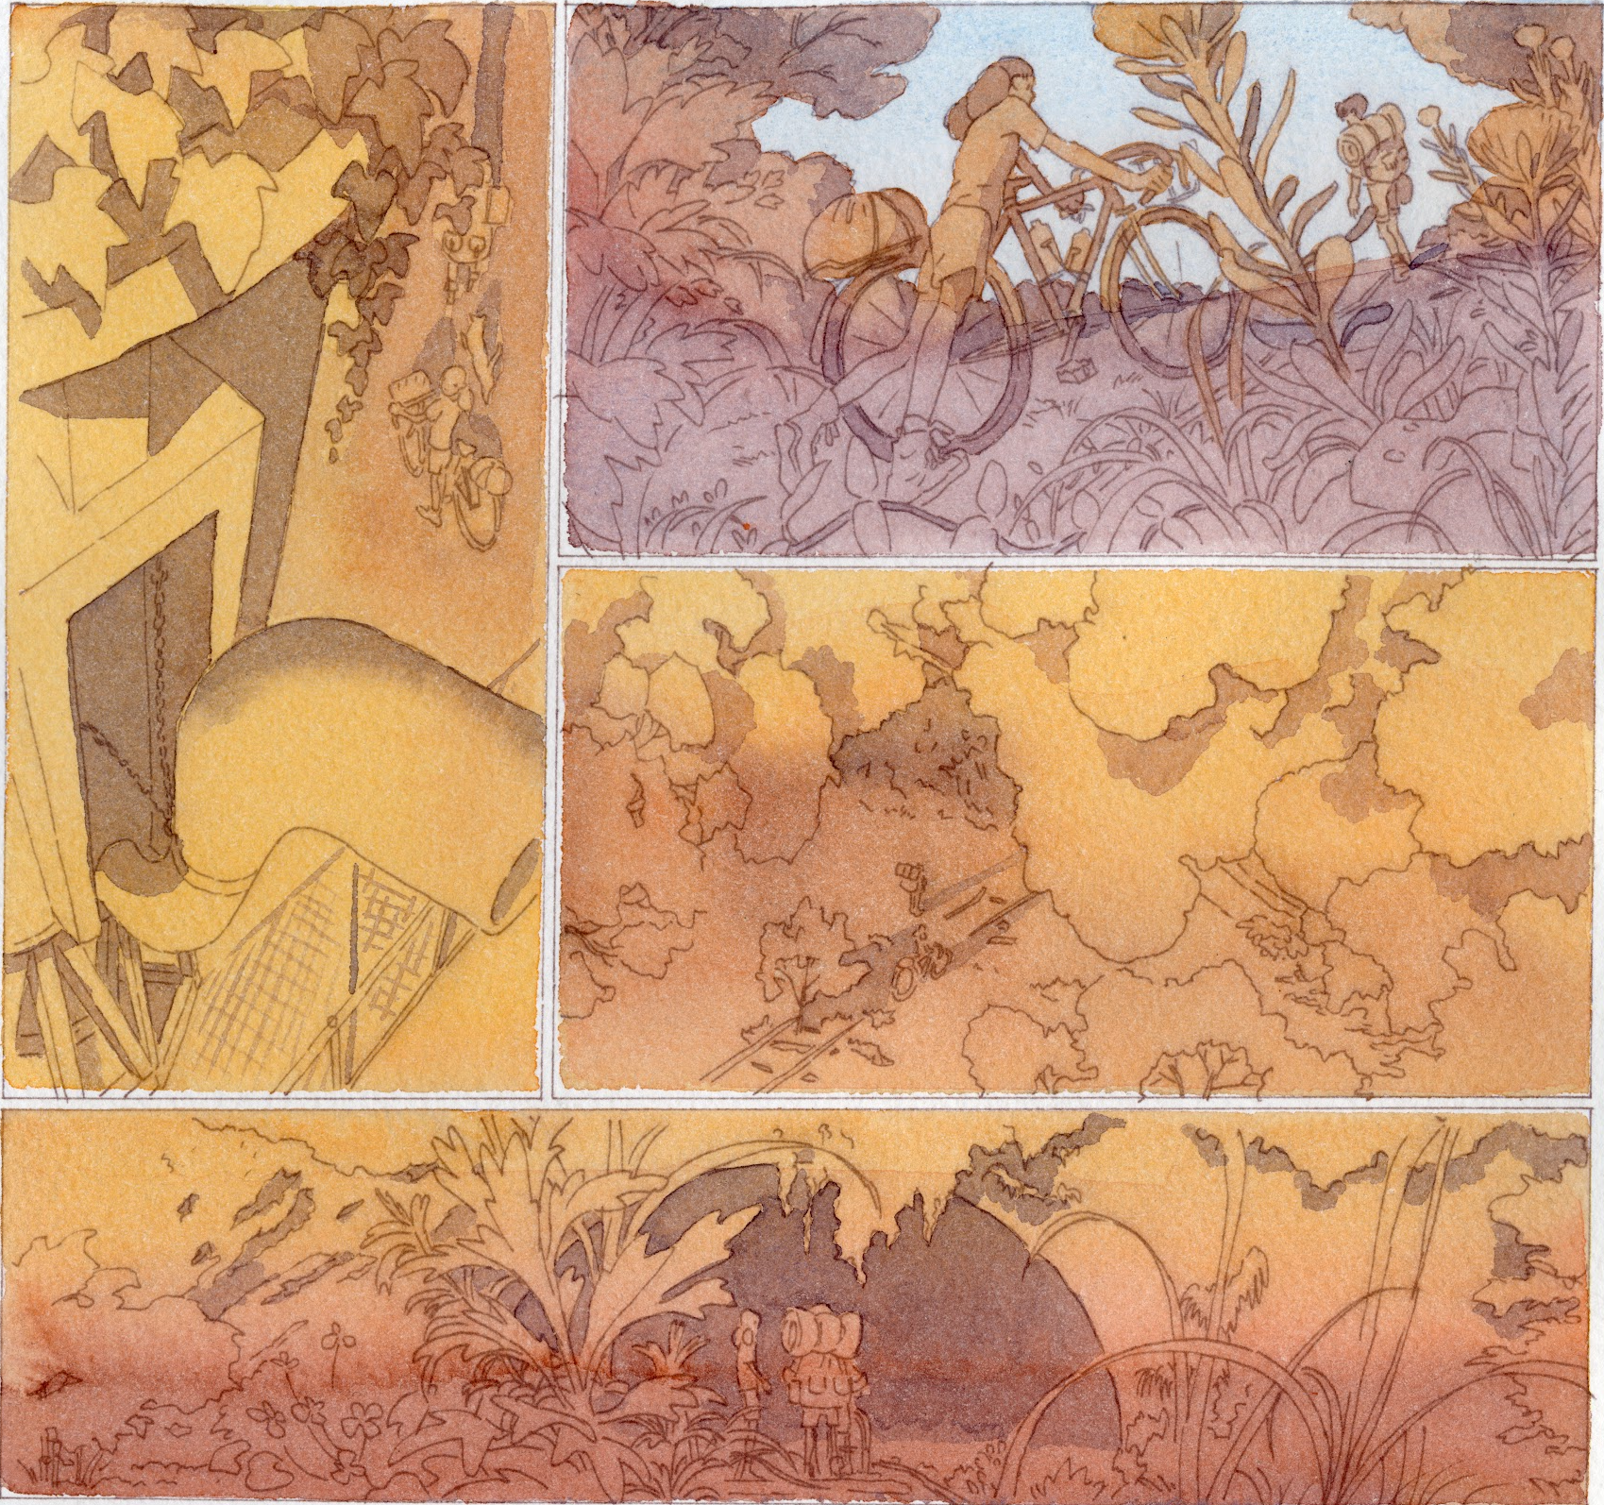
Final Art Sample 1
Page 12
Ink and watercolor

Slide 4
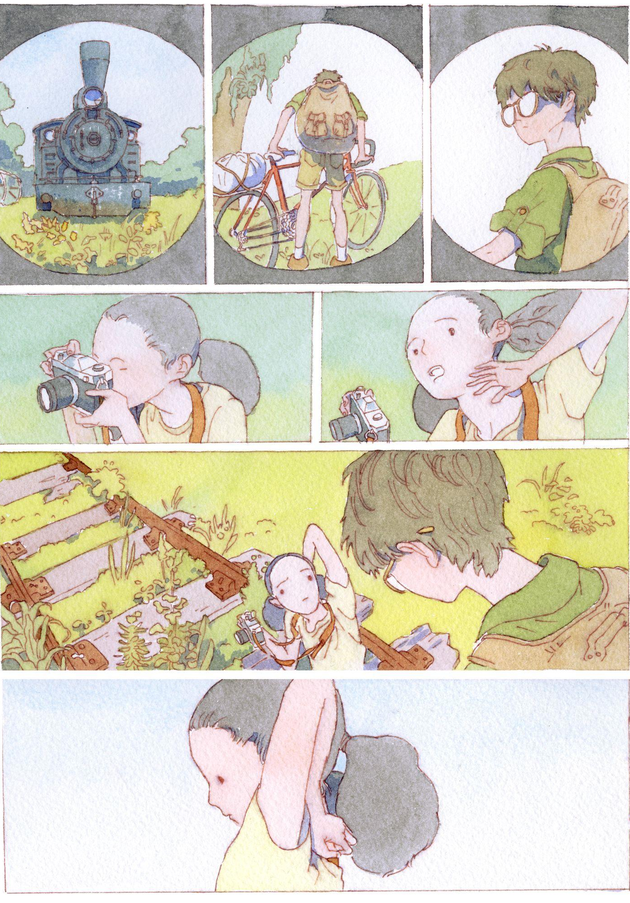
Final Art Sample 2
Page 20
Ink and watercolor

Slide 5
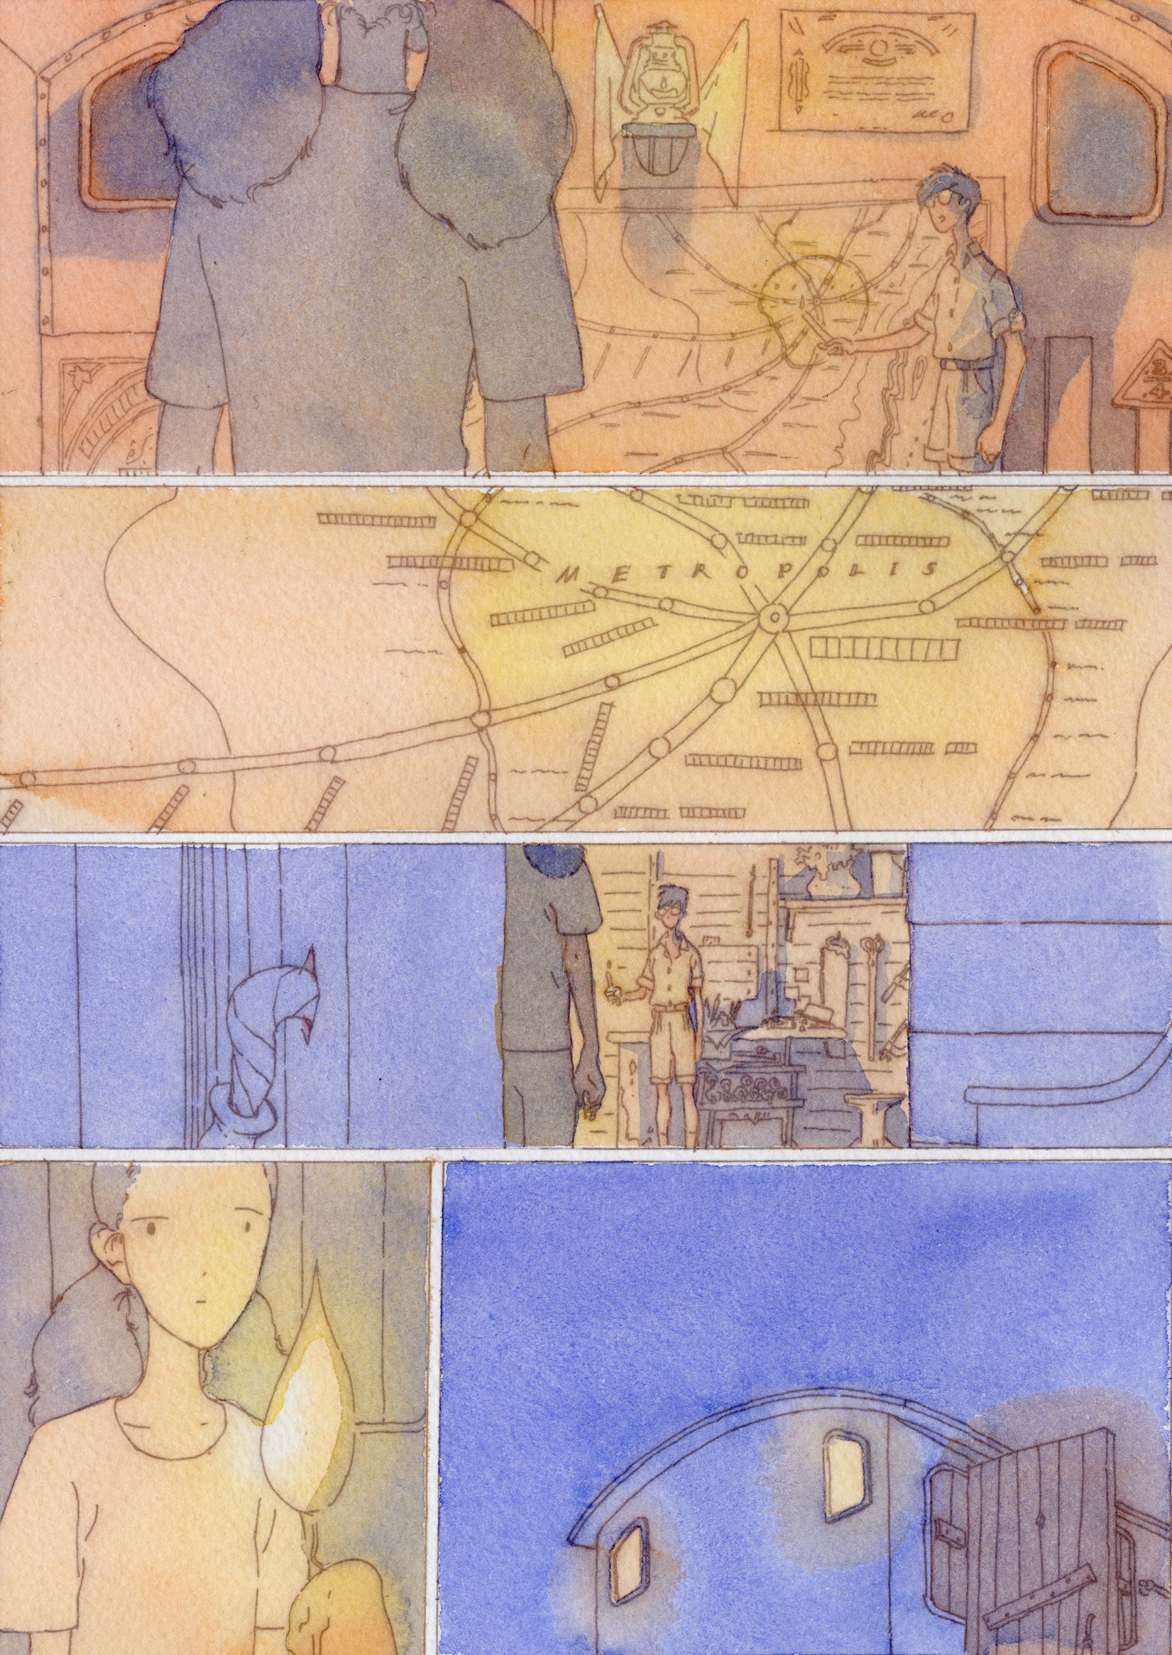
Final Art Sample 3
Page 37
Ink and watercolor

