Slide 1
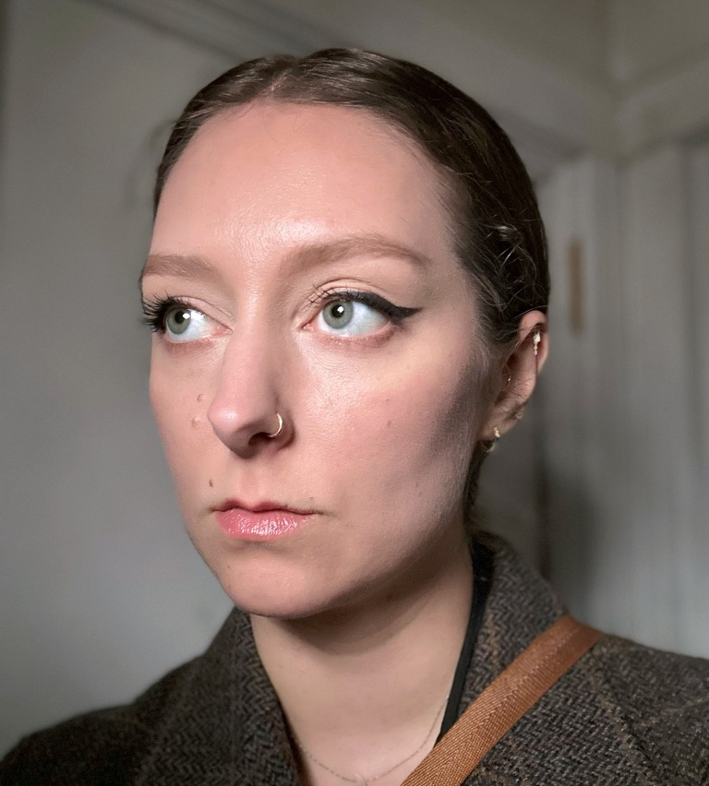
Miranda Moorhead
I am an artist and illustrator based in Queens, NY. My work weaves dramatic colors and light with myth and folklore – investigating themes of eternal human questions, emotions and beliefs through the lenses of horror, religion, and mythology. I seek to work in the publishing industry to create book covers and illustrated novels, and the entertainment industry creating posters and concept art for film, exhibition design and theater.
mirandamoorhead.com
@mirandamoorhead
Photo/Headshot

Slide 2
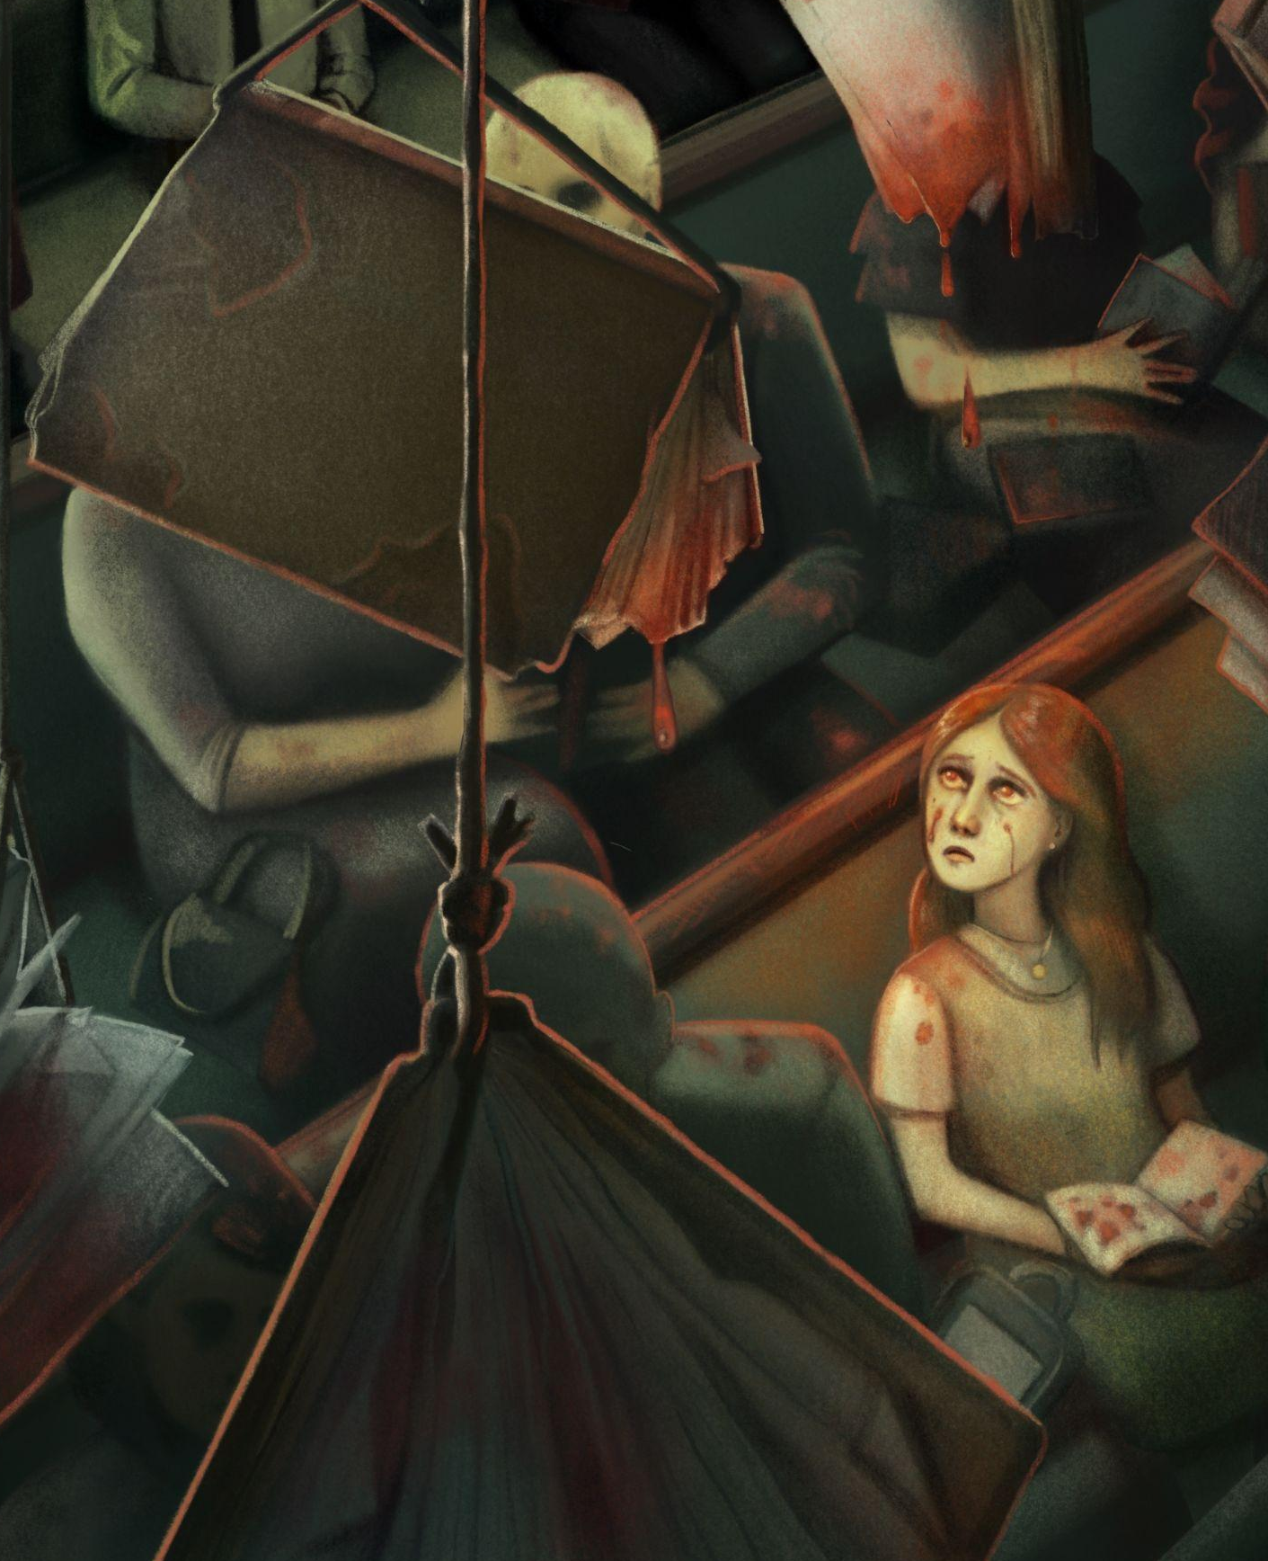
Spirit Prison
When I was eight years old, I was baptized into the Church of Jesus Christ of Latter-Day Saints (what most people know as the Mormon church). I have created a series of works that attempt to visually describe how I look back at my experience in the Church, now that I am no longer a part of it.
For this project, I wanted to create a surreal—sometimes horrific—experience for the viewer. These works are painted digitally, cut out into layers, and assembled in a puzzle-like diorama—creating a sense of shadowy depth and mystery.
While it is not possible to cover every—sometimes disturbing and harmful—facet of Mormonism in this project, I would like viewers to become curious about this fascinating and singularly American religion. I want viewers to learn about how high-demand religions and cults can affect and continually affect people long after they have left, whether they were born into it, like me, or willingly converted at an older age.
This collection of pieces is my personal artistic expression, and I have no contempt towards members of the Church, but towards the Church as an institution.
Detail of one of your images

Slide 3
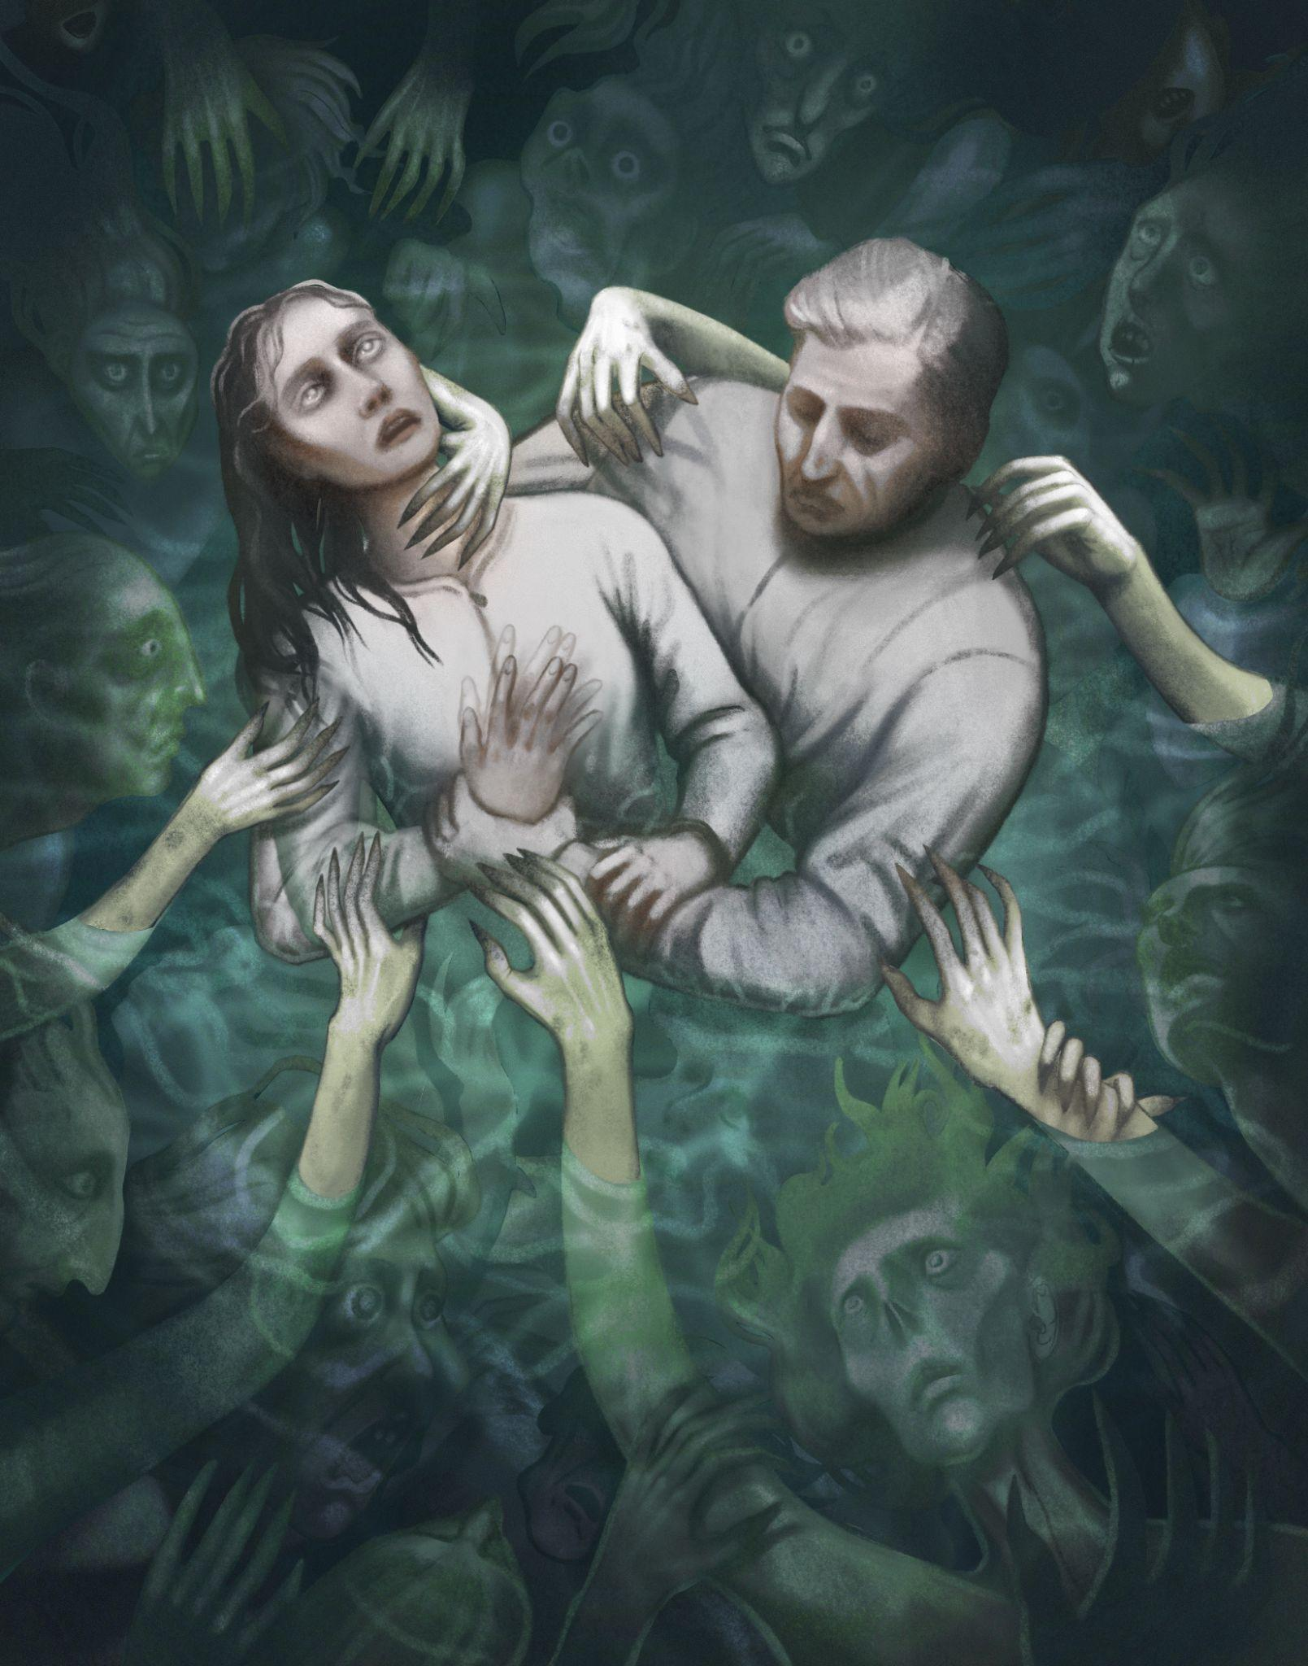
Final Art Sample 1
Immersion
Digital paint and cut paper.
13x17 inches

Slide 4
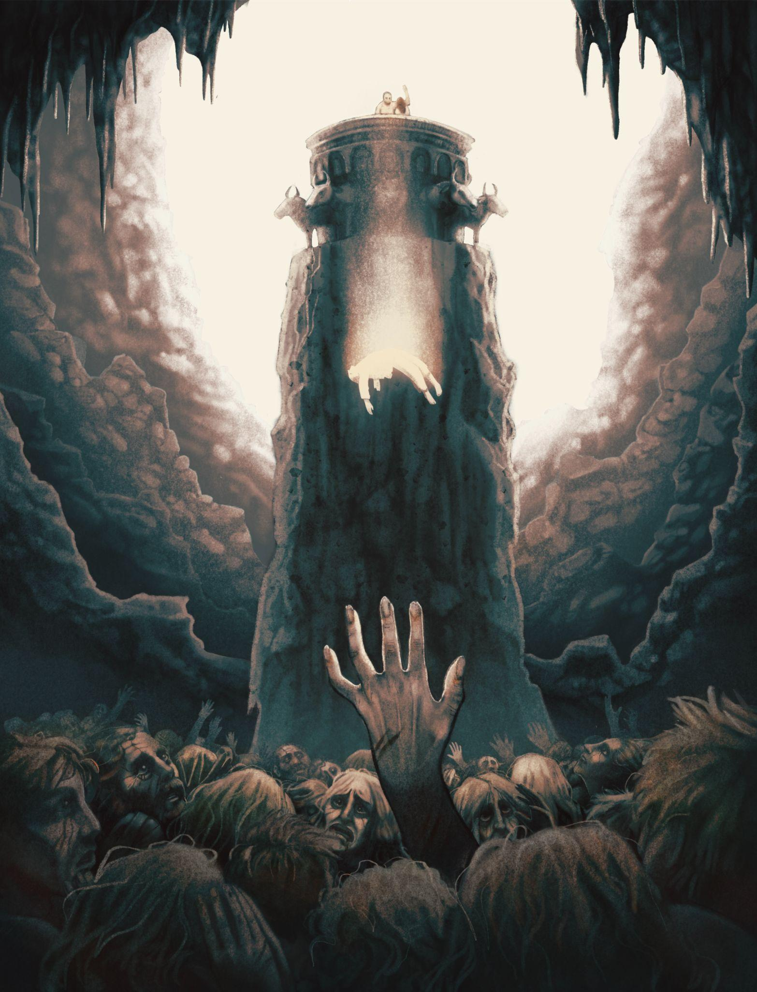
Final Art Sample 2
For the Dead
Digital paint and cut paper.
13x17 inches

Slide 5
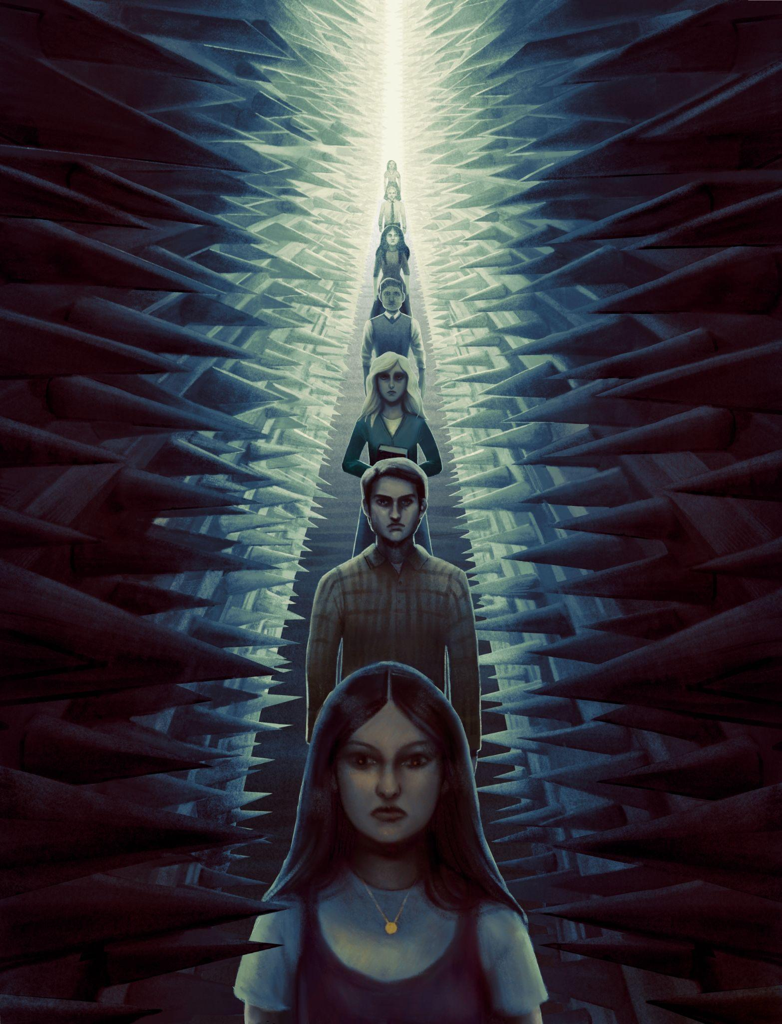
Final Art Sample 3
The Straight and Narrow Path
Digital paint and cut paper.
13x17 inches

Slide 6
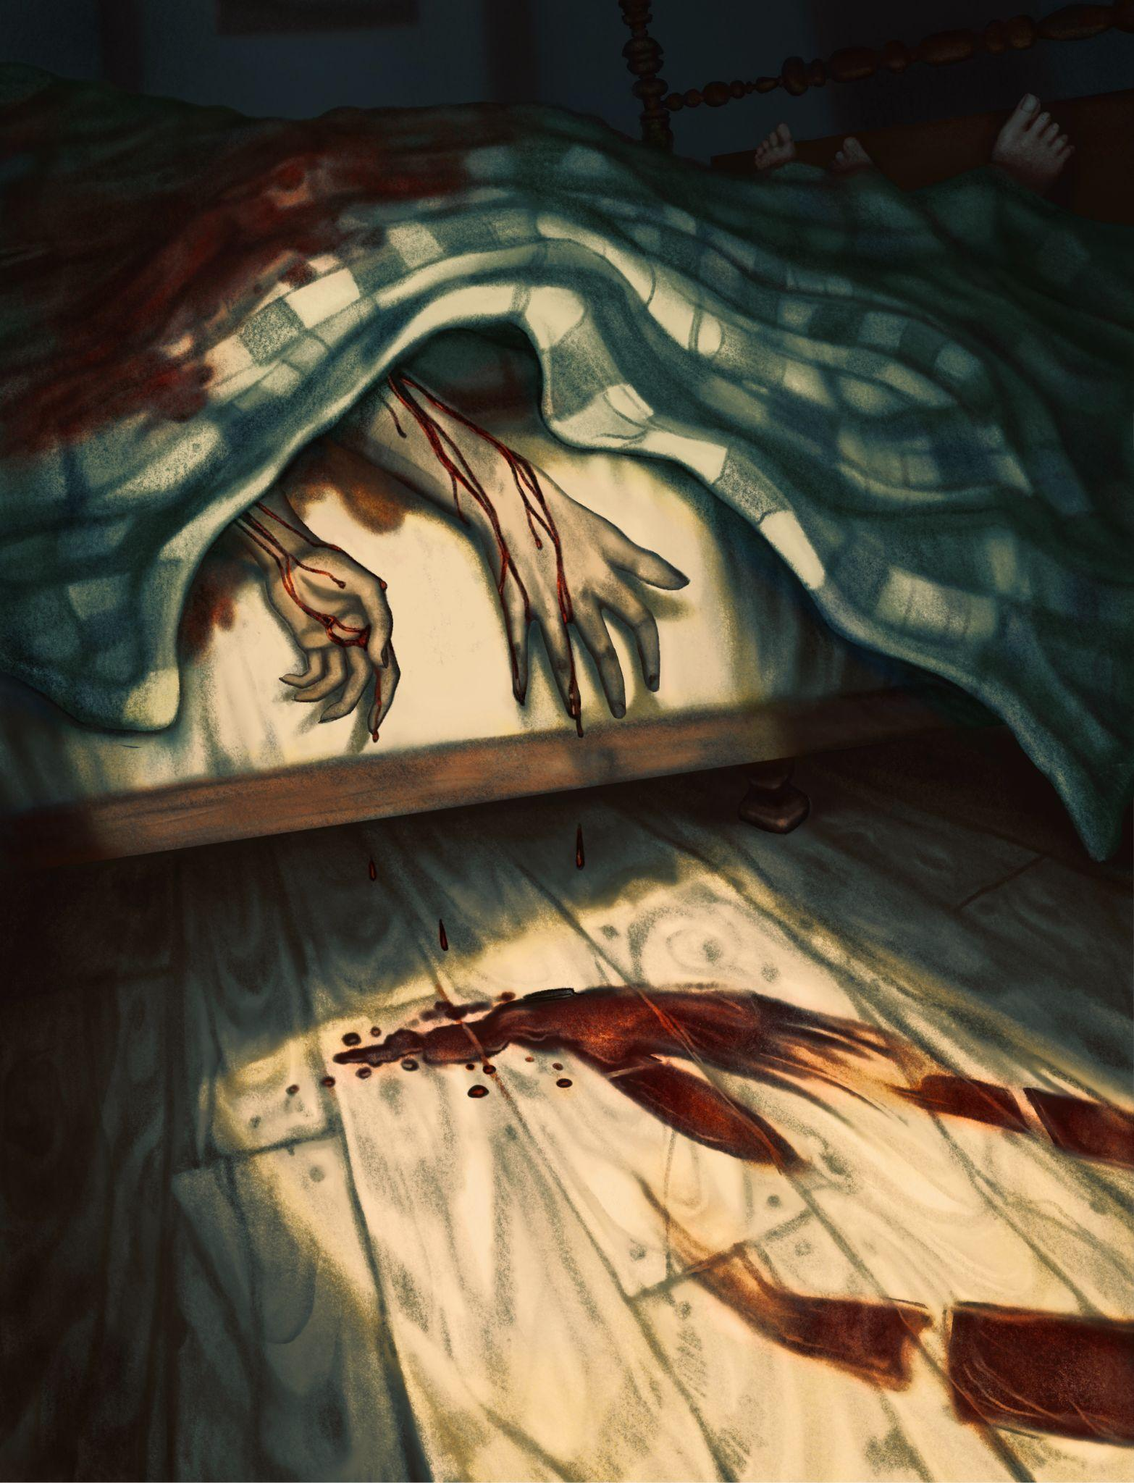
Final Art Sample 3
Blood Atonement
Digital paint and cut paper.
13x17 inches

