Slide 1
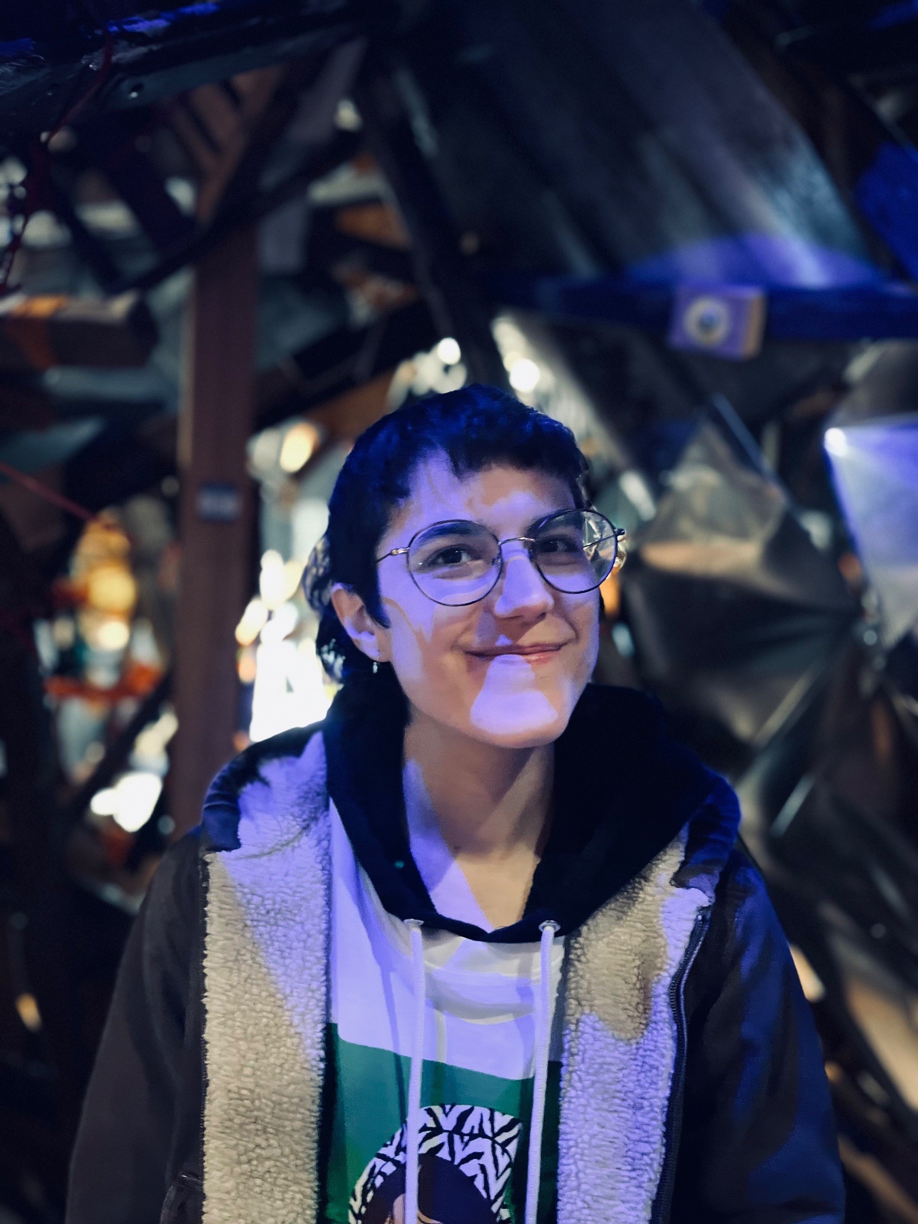
Greer De Maglie
I am a cartoonist, illustrator and MFA Illustration ‘24 candidate based in Brooklyn. I hold a BFA in Animation form the School of Visual Arts and am currently represented by Maria Vicente at P.S. Literary. I am interested in making nonfiction and fiction work based on lesser known histories and the intersections of the political and personal.
Web: greerdemaglie.com
Ig: _pictures_by_g
Email : d_demaglie@proton.me
Photo/Headshot

Slide 2
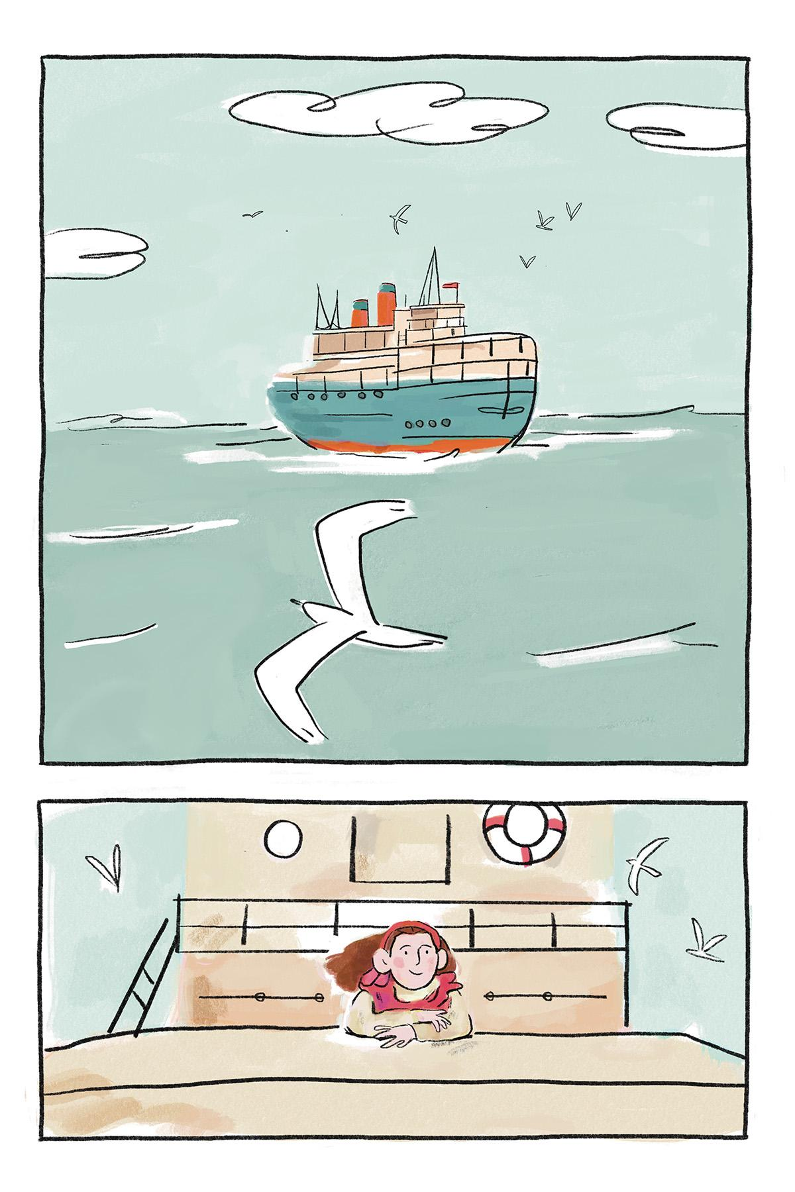
Pauline Newman:
East Side Joan of Arc
Pauline Newman: East Side Joan of Arc is a historic biography comic based on the life of queer Jewish immigrant and revolutionary Pauline Newman. Newman pioneered labor and housing laws in the United States while she and her friends faced relentless sexism, classism, and antisemitism. This is the first two chapters of a ten chapter graphic novel. I used procreate to draw and paint the 45 pages of this project, emulating pencil and watercolor.
From the moment I heard about Pauline Newman I felt a bell of curiosity and kinship resound. As I continued to pull the thread unraveling more of her story, it was apparent this was a remarkable unsung woman in history. Equally evident were the reasons for her erasure: she was openly queer, raising her daughter with her partner Freida Miller in the 1920s, a Socialist ticket nominee who stumped for presidential candidate Eugene Debs, while living through the First Red Scare, and a Jewish immigrant, who faced antisemitism throughout her career. This book is a portrait honoring Pauline and bringing her story to greater light. It also highlights the power of her friendships with other women that shared her identities, as they fought not only for safety and a living wage, but also their right to leisure, learning and joy.
Detail of one of your images

Slide 3
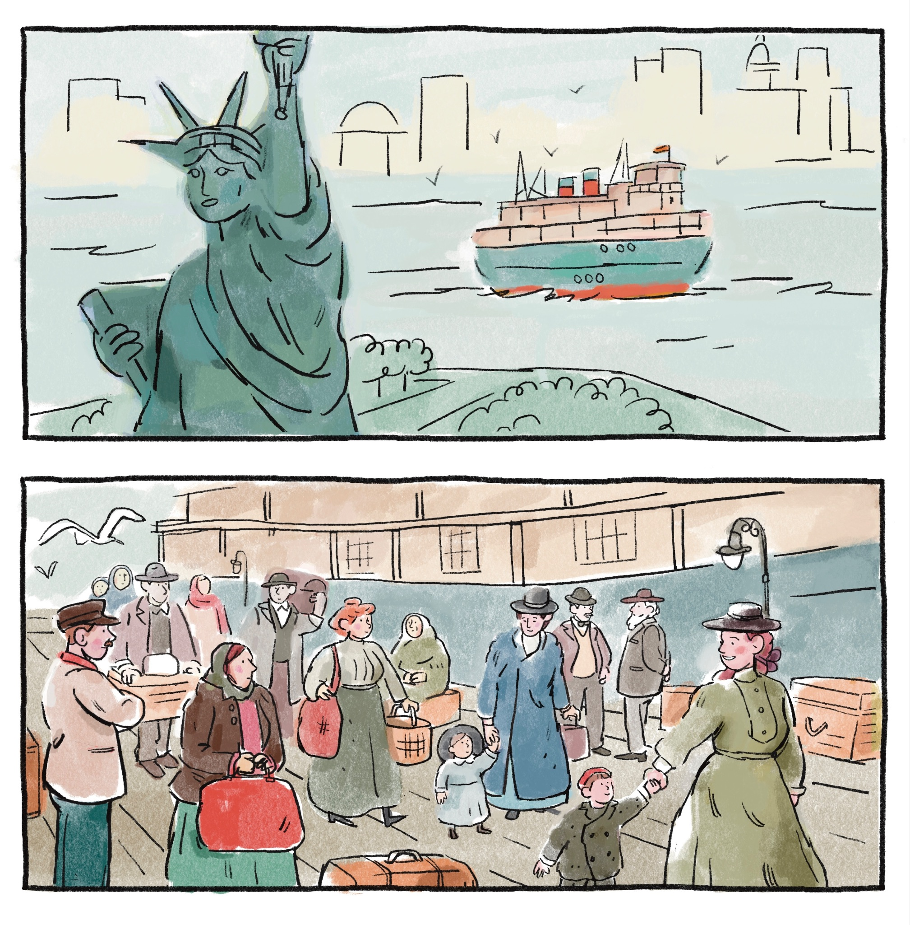
Final Art Sample 1
Excerpt of page 3
Digital

Slide 4
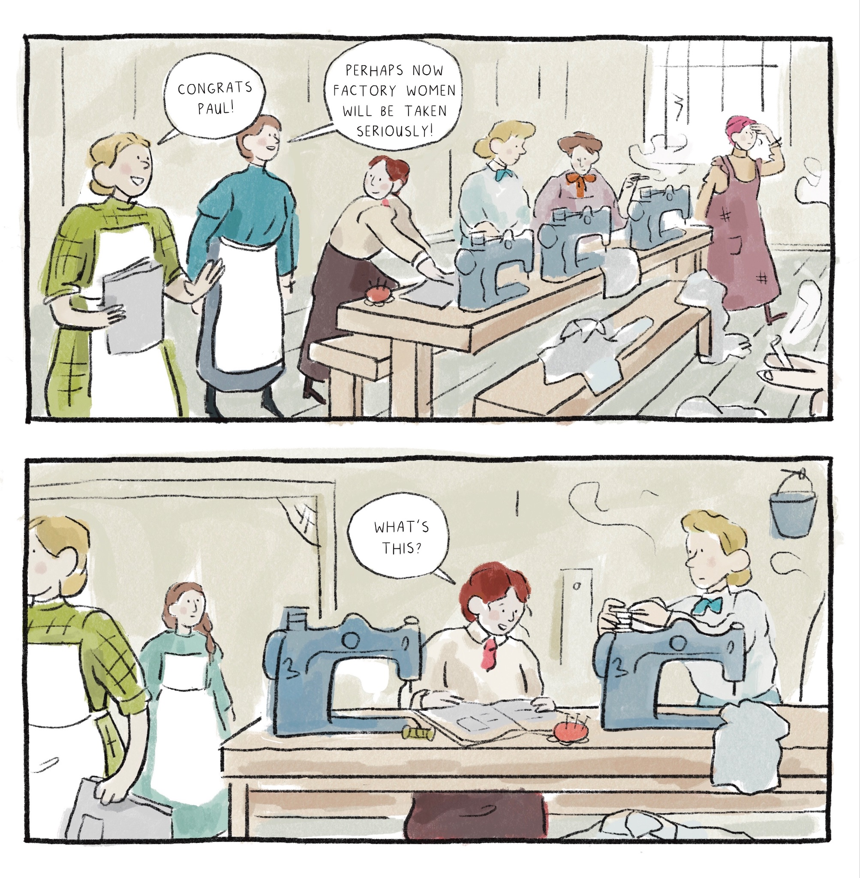
Final Art Sample 3
Excerpt of page 29
Digital

Slide 5
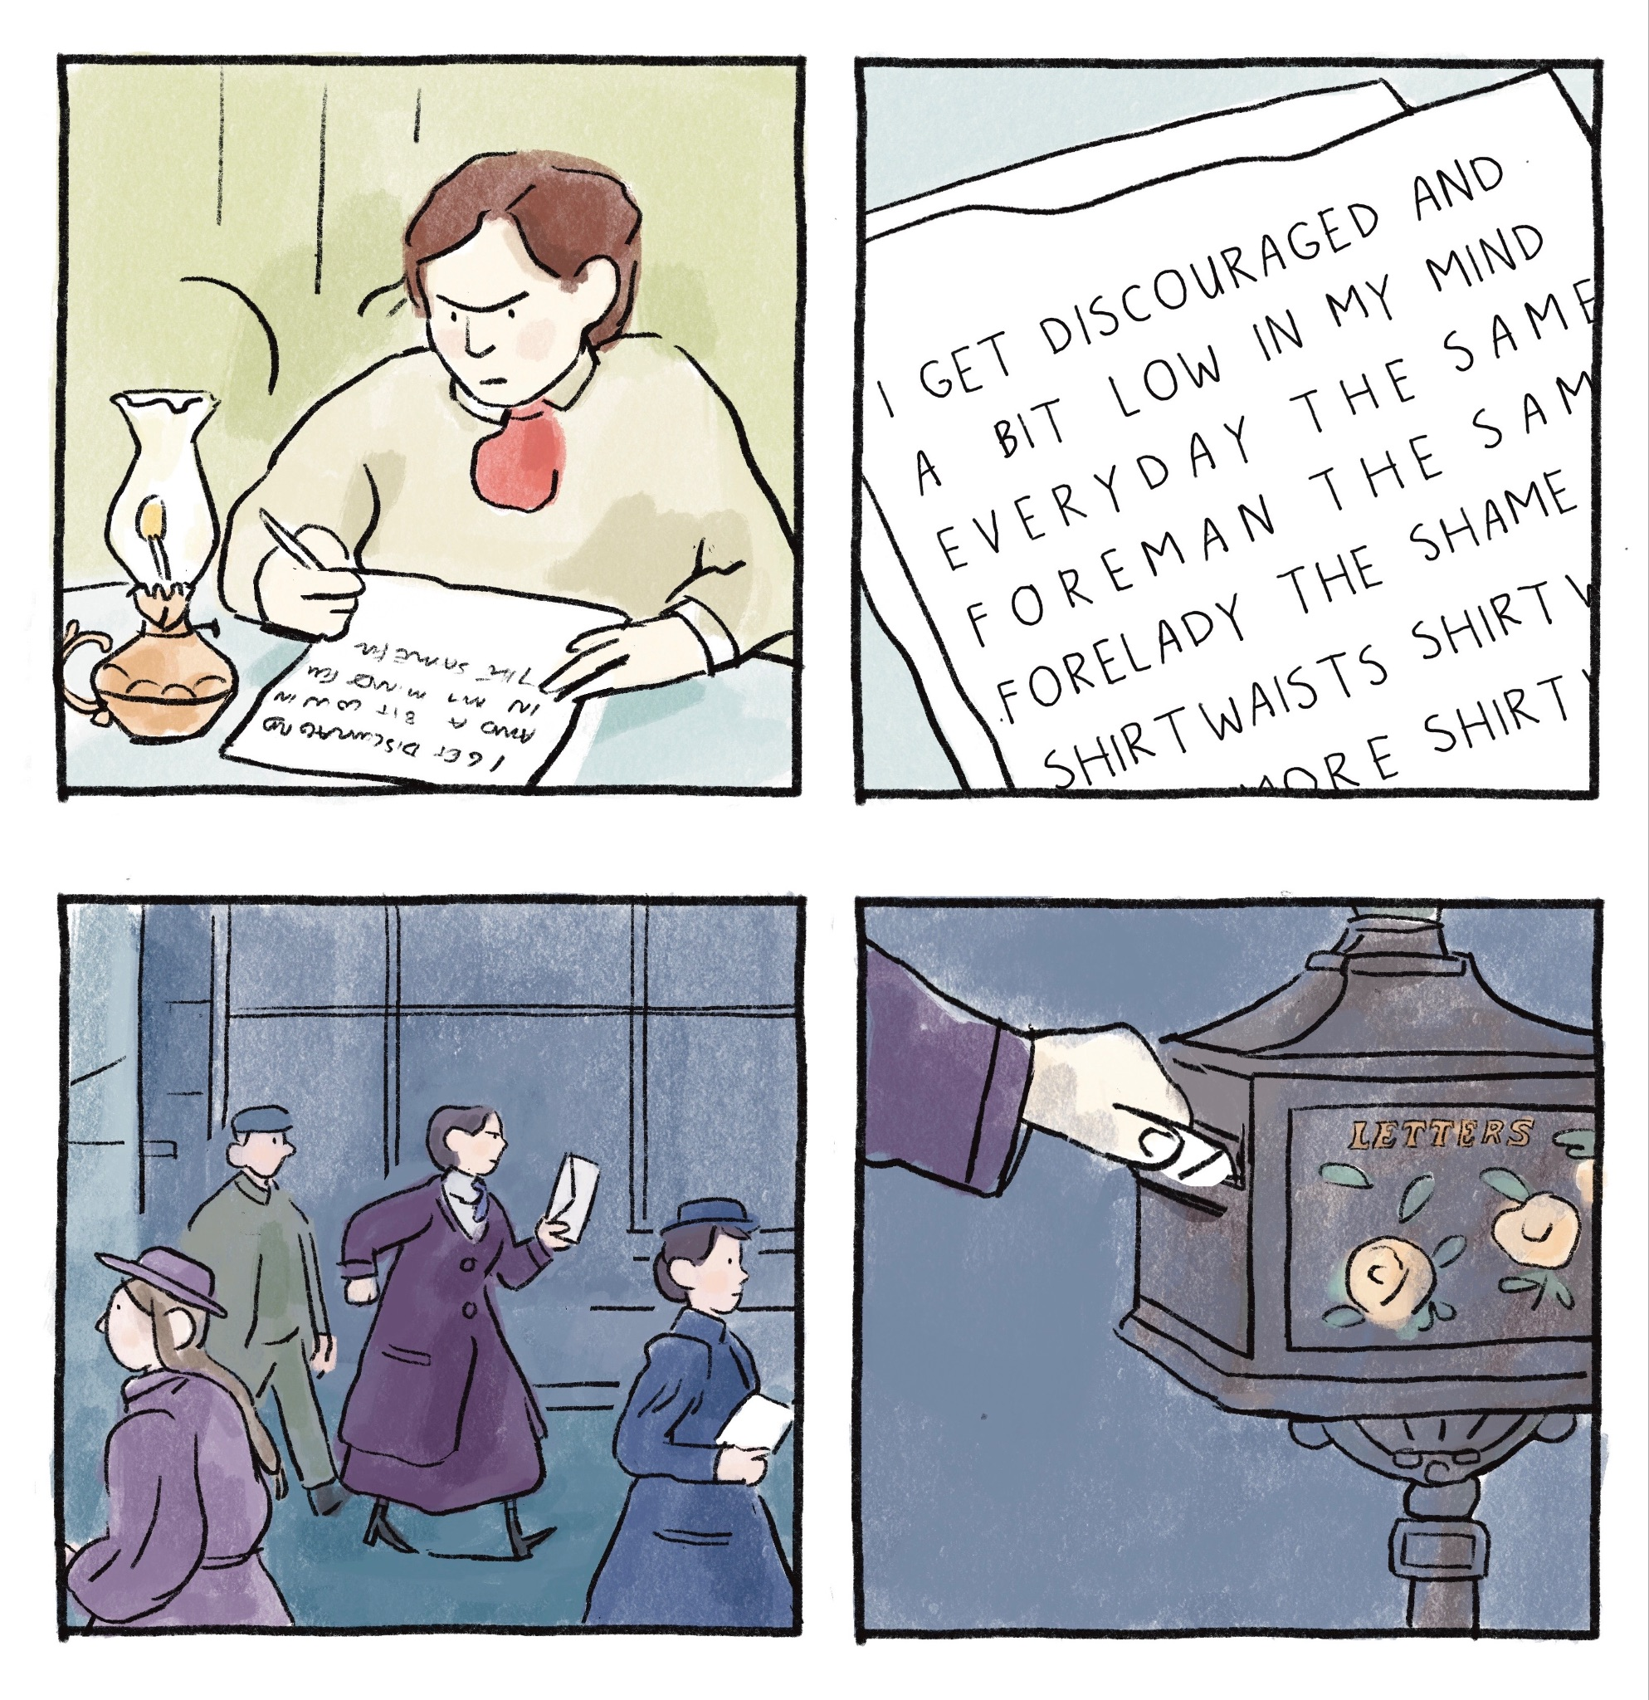
Final Art Sample 3
Excerpt of page 27
Digital

